Slide 1
Attendance Management System using Face recognition
PROJECT PRESENTATION ON

Slide 2
NAME | CONTRIBUTIONS
Nandita | Image Training Module Automatic Attendance Module Firebase Cloud Module Website Module Documentation PPT Presentation
Vaibhav | Student LOGIN Module Documentation
Shreya | Research and Survey Documentation
Saurabh | Documentation

Slide 3
ABstracT
In today's almost the whole world is connected to the Internet. All the digital devices are connected to the Internet which infuses work easier for the people. Nowadays, many of the devices are being developed using the Internet of Things (IoT), computing, image processing, and machine learning. The system had been developed for appraise the attendance of the student and recognition of the student faces for marking up the attendance. The system is enacted to form a classroom attendance system that uses the concept of face recognition as today's manual attendance systems become more time-consuming and cumbersome to keep up properly. A database of all the students with their details is stored in the firebase cloud, and attendance is recorded when the face that is recognized by the system is available in the database which had been done through training of the images. The system is designed and developed in python language .It has its own face recognition method and listening features using the (LBPH) Algorithm" within the project of the OpenCV library. It uses "Haar Cascade Classifier". It uses Tkinter for GUI and Firebase for the database.
Keywords: Face Recognition, Face Detection, Haar-Cascade Classifier, Local Binary Pattern Histogram (LBPH), Tkinter, OpenCV, Firebase Cloud

Slide 4
Problem Definition
The use of digital paper based manual attendance system by giving the lecturers attendance sheet to check whether the student is attended the class or not. For the sake of this system many problems has faced that manual system.
.
The teachers need to hire student attendance sheet Excel to collect and file student attendance is lost.
Loss of instructional time production to search students on the attendance sheet.
Statistical information is not easily to be derived.
Attendance records are not communicated efficiently.

Slide 5



Objectives
Spots the presence of attending students and providing the timing of the attendance marked.
Capable of storing maximum records and no need of manual attendance
Only students are responsible for making attendance of their own

Slide 6
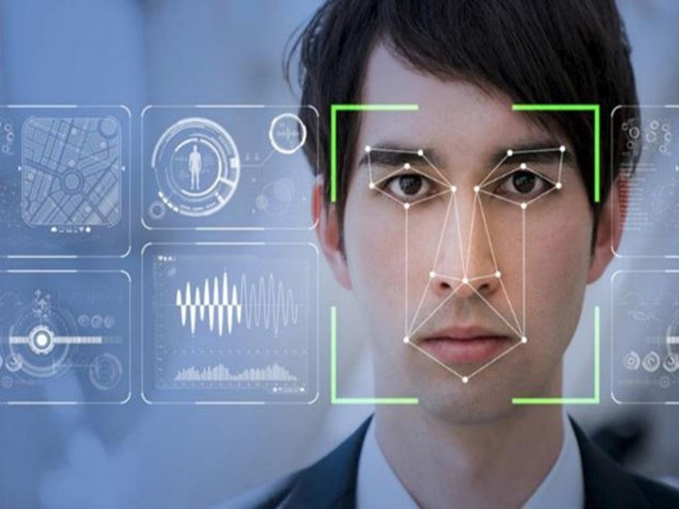
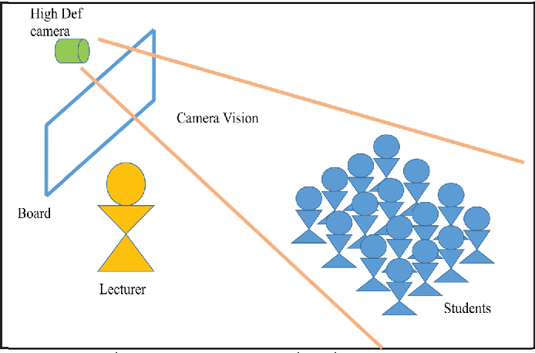
Introduction
Attendance Management System Using Face Recognition is a system developed for daily student attendance in schools, colleges and institutes. Face recognition could be a trending technology almost utilized in every area from security, research, automation and lots of more things. and that we are aiming and targeting on the attendance of the scholars by applying OpenCV and a few python’s inbuilt functionality. we've got also used text to speech library.

Slide 7
Survey Analysis
Paper Title | Technology Used | Paper Title | Technology Used
Attendance Management System Using Face Recognition and Body Temperature Sensing | Use of MLX90614. Used of OpenCV, Face Detection, Face Recognition, Body temperature sensing | Android-based attendance management system | Device camera is used as sensor Internet connection required for the downloading of the student's list from the webserver. Sensor used to read the barcode.
Attendance Management System Using Facial Recognition | Binary pattern algorithm Compared Using classifier | Wireless attendance management system based on iris recognition | Implementation of Daugman's Algorithm attendance personal identification and biometrics are used
Fingerprint Based Attendance Management System | Used of fingerprint sensor | Mobile- Based attendance management system | student information such as present or absent through mobile device regarding internal marks, semester marks and other activities involved in the organization.
Bluetooth based Attendance Management System | Bluetooth connection for transferring media | An implementation of attendance management system using NFC | web-application and the android version app-application for students. develops a prototype NFC tags attached in desk in classroom embedded with smart phones
Face and Face Expression Recognition | Computer vision field and Mental state recognition | Embedded Computer Embedded Computer Computer-Based Lecture Attendance Based Lecture Attendance Management System | Electronic card-based and single chip based subsystems Error free and faster verification for authenticating students.

Slide 8
Technology Used
Machine learning - LBPH algorithm, haarcascade classifier
Image processing - python open CV library
GUI – tkinter library
Database – firebase cloud real -time database and authentication
Cloud technology – paas (hereoku application)

Slide 9
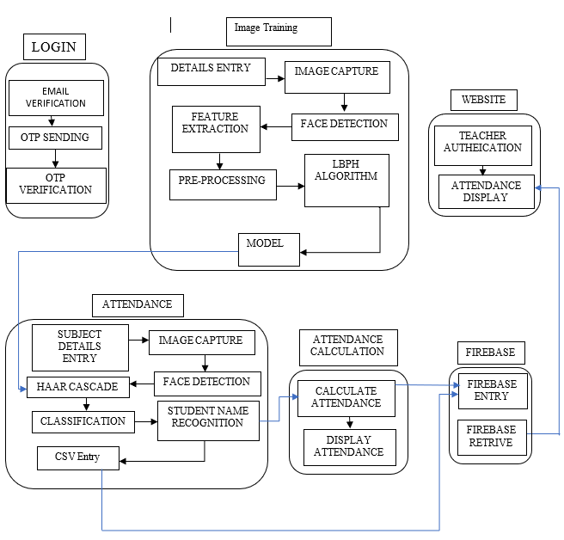
SYSTEM ARCHITECTURE
The system architecture process is developed where the concepts that will be the backbone of the system and where the actual system is developed. It describes the conceptual model that shows the structure and behavior of the proposed system or of an existing system. The architecture includes the technical framework, end user requirements, and a list of the system components.

Slide 10
Modules Of the System
WEBSITE
Student Login
Image Training
Attendance
This module is adds the creation of website for the project and displays the data of the project.
This module is cast-off for the login purpose of system used by students for marking their attendance.
Responsible for Image processing which takes 50 images and trains image
Firebase cloud
This module is utilized for targeting towards the database for the system
Automatic Attendance
Display Attendance
This is main module that is responsible for evaluating the attendance of the present attending students.
This module is used for displaying of attendance of students which is checked by teachers.

Slide 11


Requirements Analysis
Functional
Non-functional
Only authorized user must login to the system.
The system must be attached to webcam and face recognition should be smooth.
The information must be entered and managed properly.
The administrator or the user who will use this system must login before using it.
Accuracy and precision must be process to avoid the problems system performance.
The system is easy to use.
The system is secured and privacy of the student’s details.
Speed and responsiveness for the execution of the system.

Slide 12
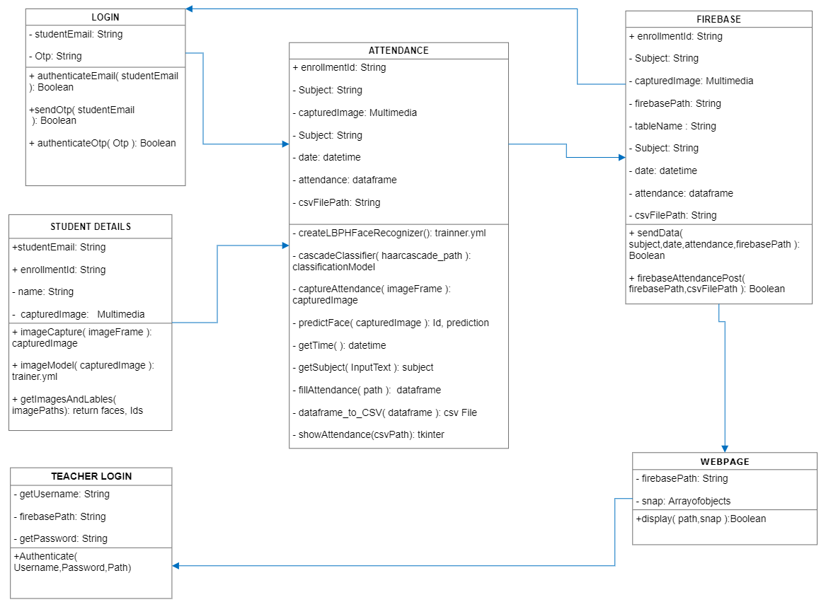
Uml Diagram
The class diagram elaborate that how the login modules, student details attendance ,firebase, teacher login and webpage are connected to each other. The static view of the system is shown through this diagram.
Fig 1: CLASS DIAGRAM

Slide 13
Database Description
Name
Email
Teacher Id
Password
Enrollment Id
Student
Teacher
Username
views
takes
Attendance
datetime
Subject
Enrollment Id
Name
Fig 2: ER-DIAGRAM

Slide 14
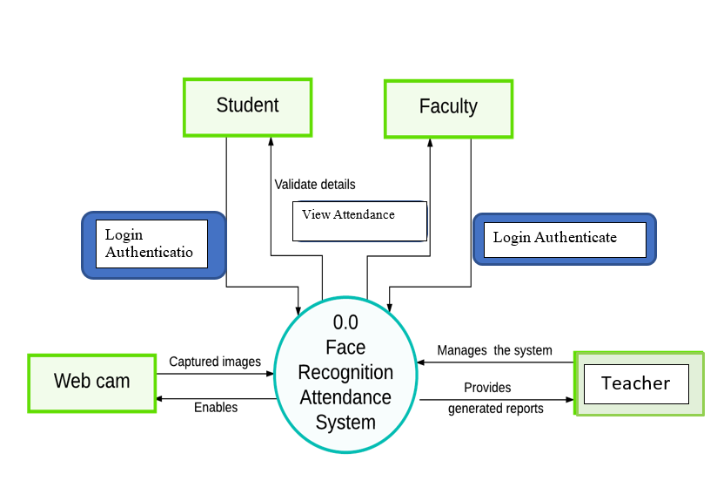
Context-level diagram

Slide 15
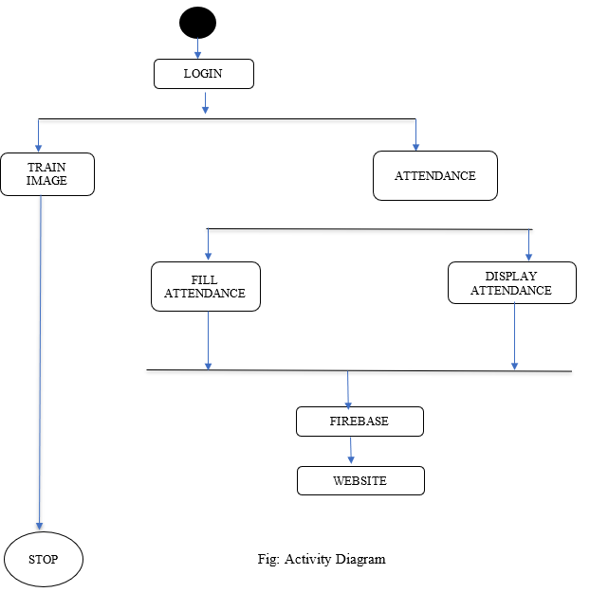
OVERVIEW OF SYSTEM

Slide 16
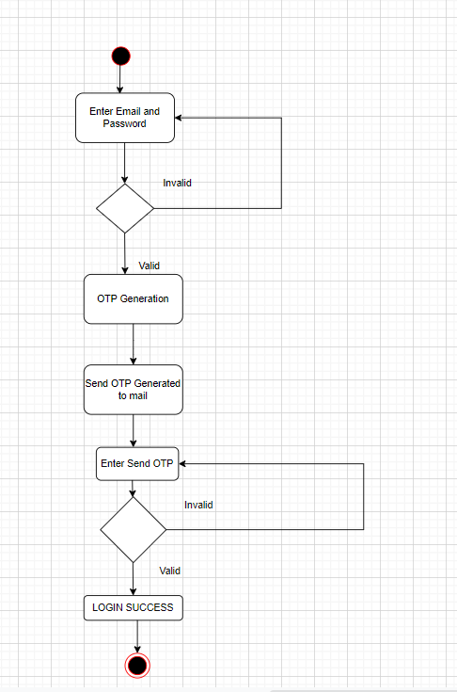
login module
The diagram aside shows the activity that are done in the login module. Firstly, the student should enter their login details and after verification of that the OTP is send to the mail of the student. After entering the send OTP the login module will be successfully logged in.

Slide 17
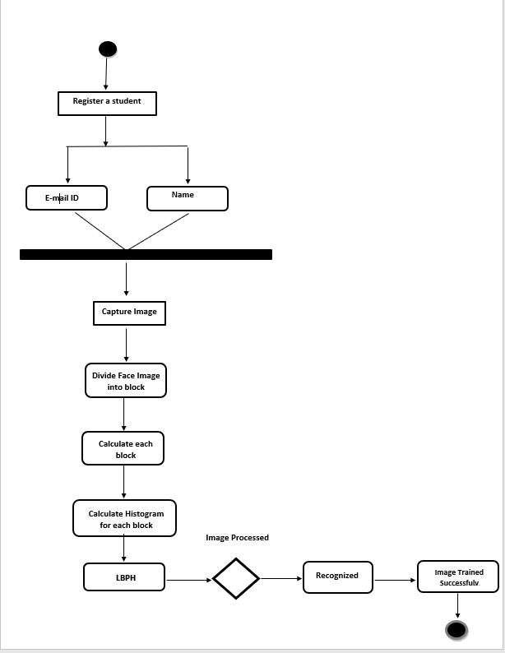
training Image
Training data is also known as a training set, training dataset or learning set. This module is used in this project from capturing the image and training of the image to recognize the faces of the students given to train.

Slide 18
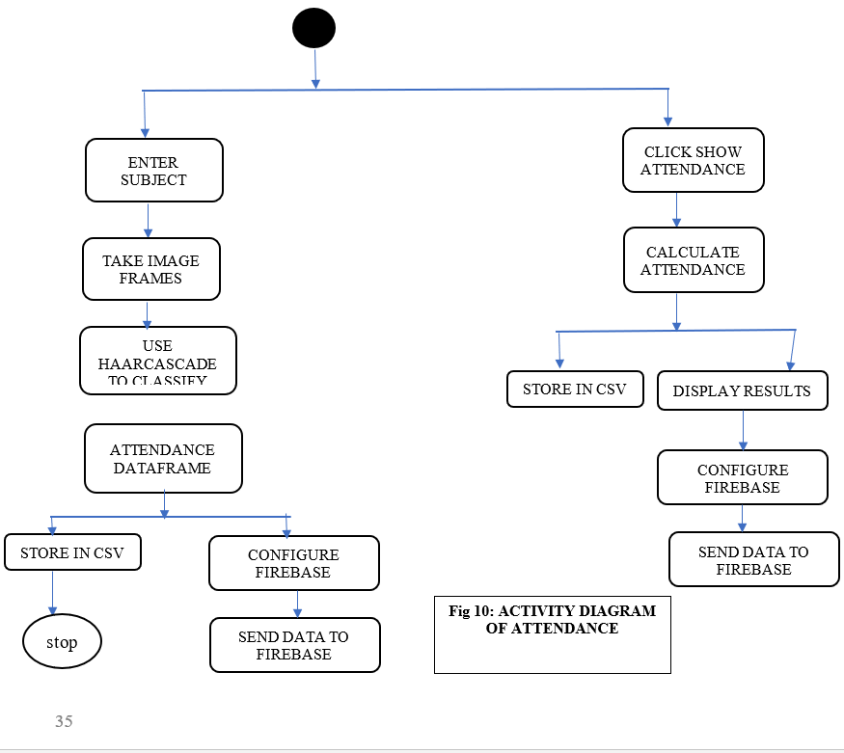
Attendance
This module of the system is used for activity of taking attendance of the students at particular timing entering their enrollment ids and subject in which they want to fill the attendance. This is the main module of the system which has the main process of marking the attendance of the students. This module will also show the marking of the attendance and student attendance.

Slide 19
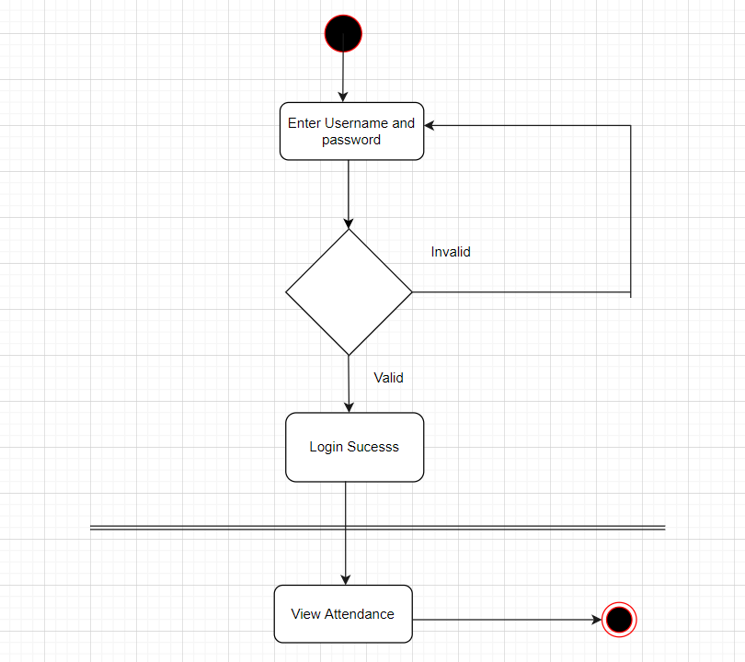
WEBSITE
The user who are willing to login through website must provide login details for accessing the website system. The website is designed using HTML, Tailwind CSS and JavaScript. The website demonstrations the databases stored in the system in the tabular format. The link of our website is:
https://attendance-mgnt-system.herokuapp.com/

Slide 20
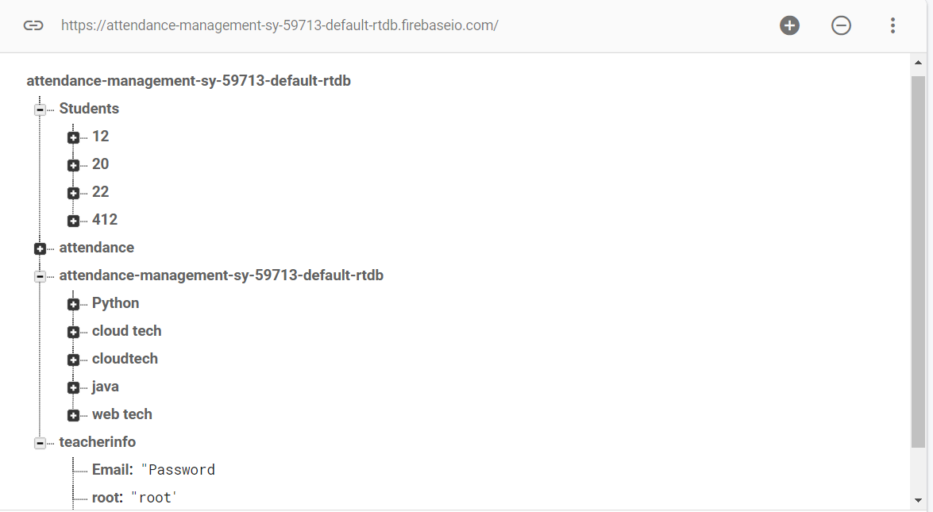
FIREBASE DATABASE
Cloud storage for firebase is built for app developers who need to store and serve user-generated content, such as photos or videos. Cloud Storage for Firebase is a powerful, simple, and cost-effective object storage service built for google scale.
The firebase SDKs for cloud storage add google security to file uploads and downloads for your firebase apps, regardless for network quality.
The system can use SDKs to store images, videos, audios, or another user generated content. On the server, you can use google cloud storage APIs to access the same files.

Slide 21
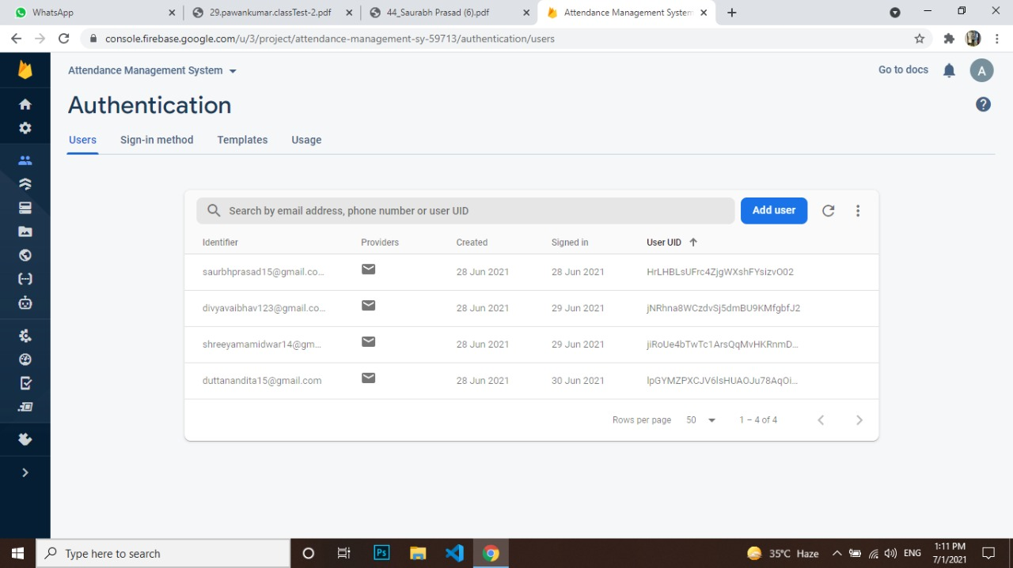
FIREBASE AUTHENTICATION
Firebase Authentication provides backend services, easy-to-use SDKs, and ready-made UI libraries to authenticate users to your app. It supports authentication using passwords, phone numbers, popular federated identity providers like Google, Facebook and Twitter, and more.
Firebase Authentication integrates tightly with other Firebase services, and it leverages industry standards like OAuth 2.0 and OpenID Connect, so it can be easily integrated with your custom backend.

Slide 22
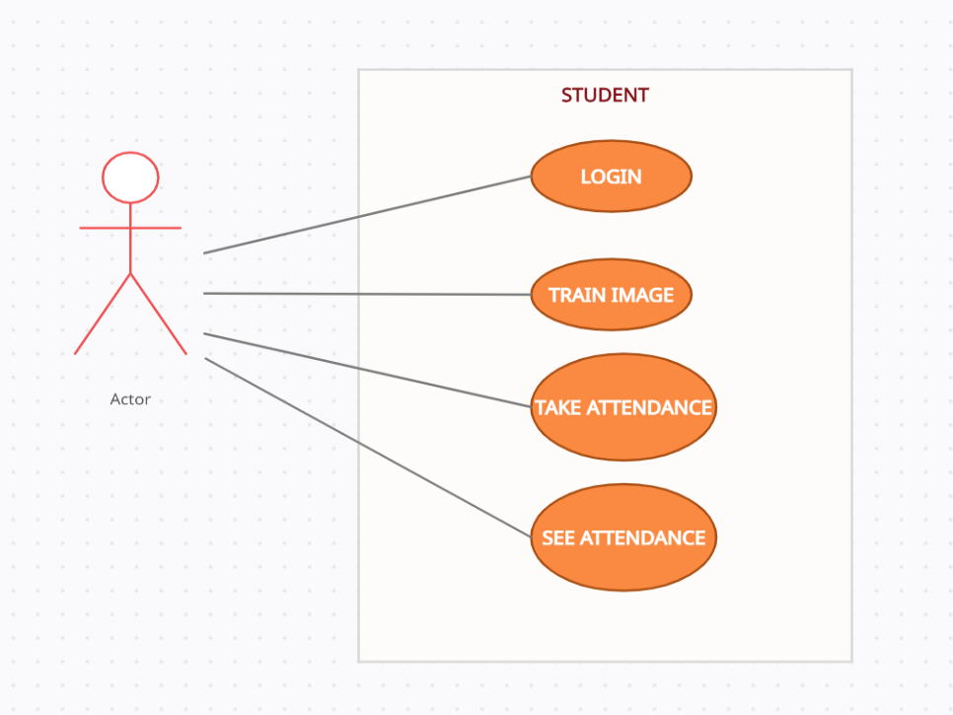
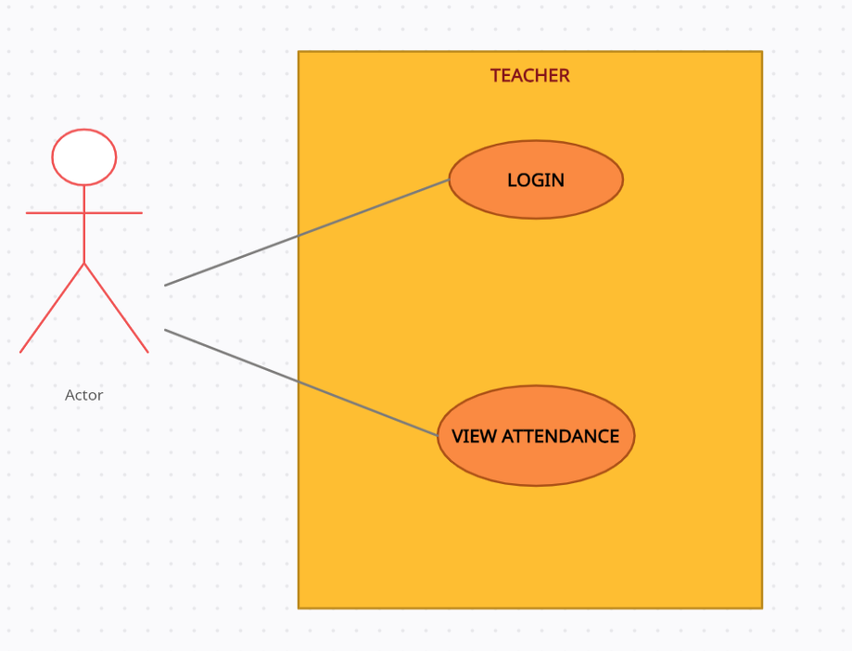
USECASE DIAGRAM FOR STUDENT
USECASE DIAGRAM FOR TEACHER
Faces of the students are detected by the system and the attendance is marked for the particular subject.
The teacher is only responsible for login to the system and evaluates and views the student attendance.

Slide 23
PERFORMANCE ANALYSIS
Descriptions | Parameter
Accuracy of LBPH | 65%
Time to train model | 50 secs
Time taken to recognize | 530 milli secs
Time taken to transfer data to firebase | 540 milli secs
Size of data transfer to firebase | 523 kb
Data Storage capacity | 4.0 MB
Software run time errors | 0 Errors
Total file size | 1119.8 KB

Slide 24
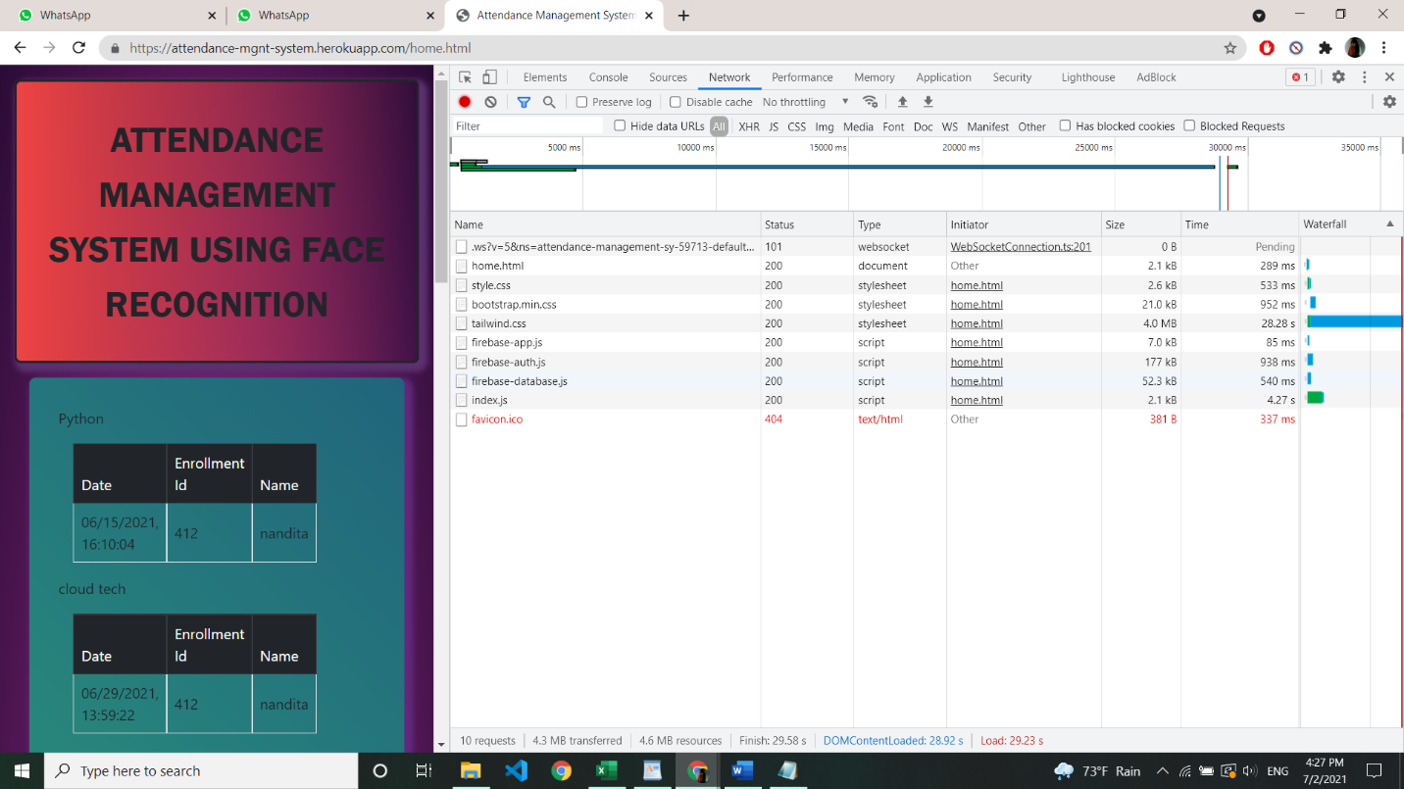
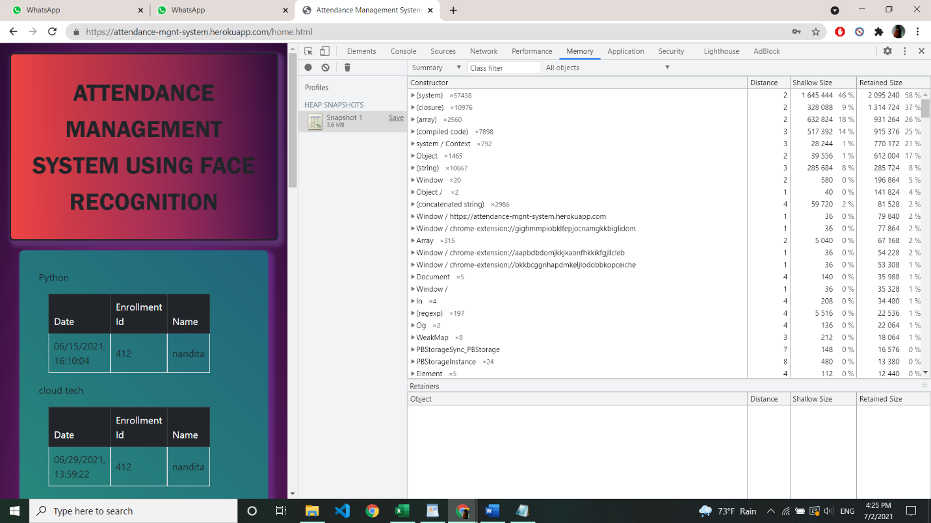

Slide 25
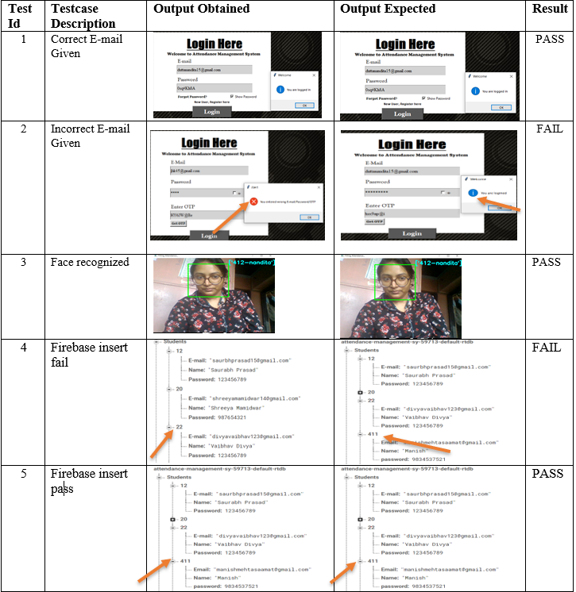
TEST CASES

Slide 26
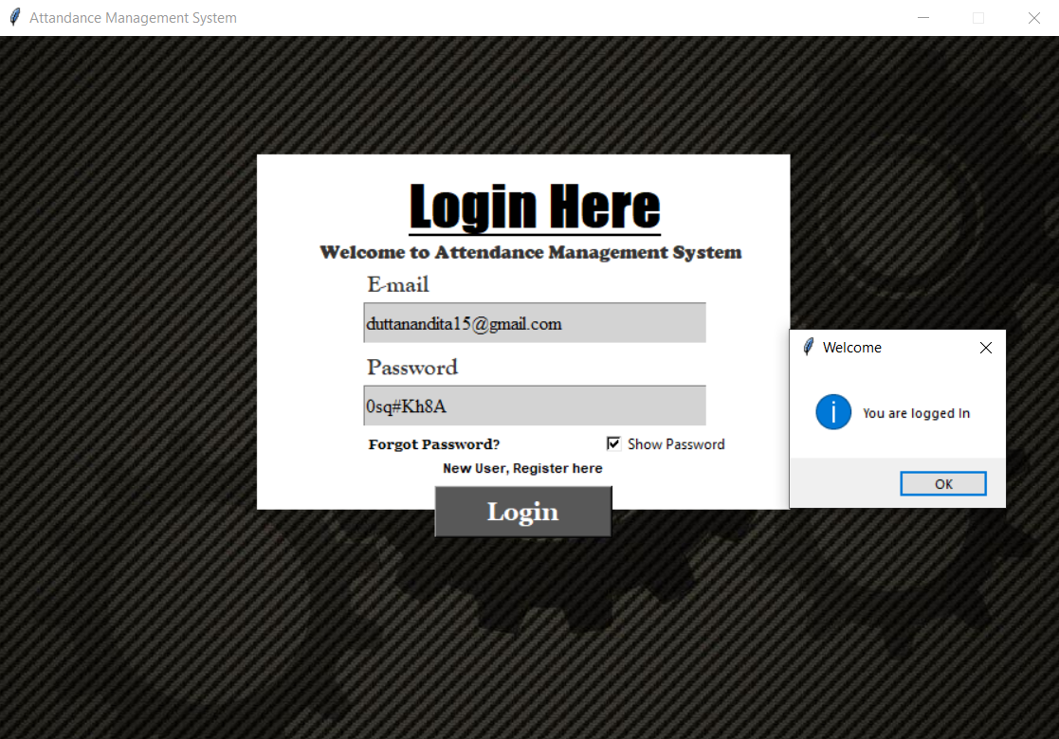
RESULT OBTAINED
LOGIN SNAP OF SYSTEM

Slide 27
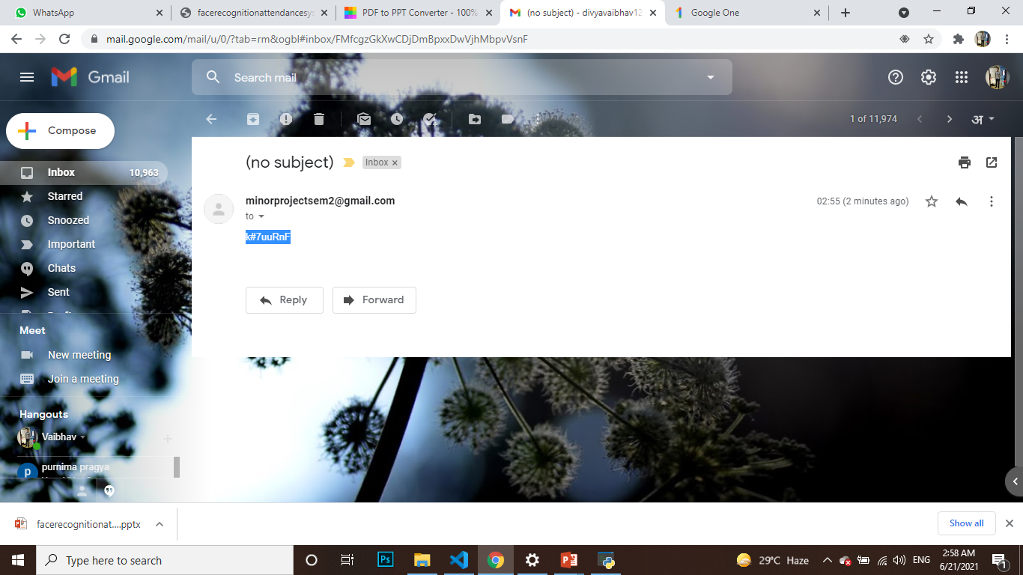
AUTOMATED OTP GENERATED THROUGH MAIL SNAP

Slide 28
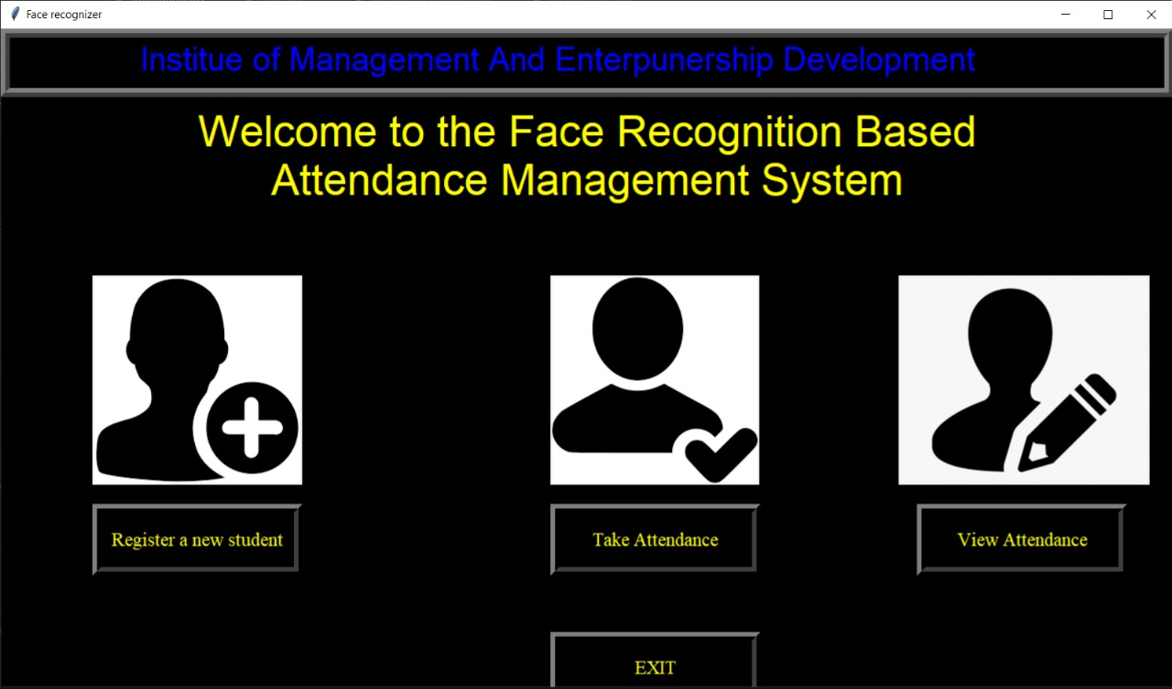
MAIN SCREEN OF SYSTEM

Slide 29
FIREBASE DATABASE SNAP

Slide 30
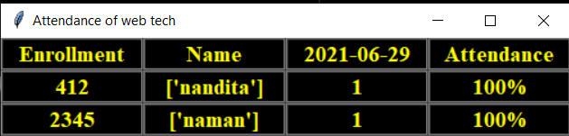
ATTENDANCE DISPLAY

Slide 31
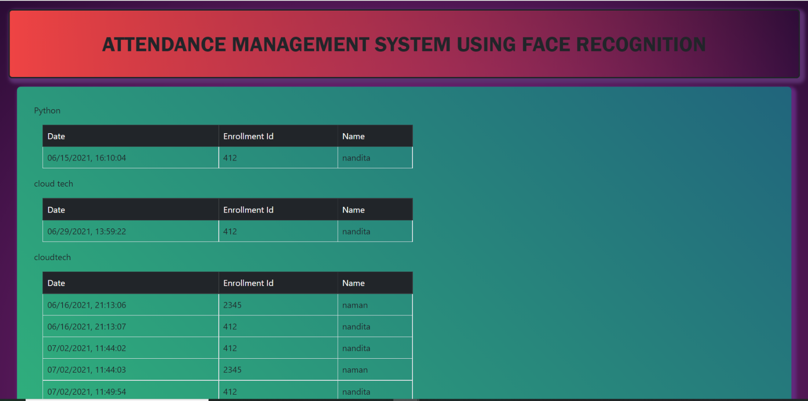
ATTENDANCE DISPLAY ON WEBSITE

Slide 32
Conclusion AND FUTURE USE
This system is very simple in term of calculation and improve speed as well. It required only one scanning without any need to a complicated analysis. Face recognition technology have been associated generally with very cost top secure systems. Today the core technologies have evolved and the cost of equipment is going down dramatically due to the integration and the increasing process power. Certain systems of face recognition technology are now cost effective, reliable and highly accurate. That why attendance management system using face recognition helps us in any school, colleges, and any kind of company as well.
We can use this technology in other ways as well, further expanding the monitoring to track specific students on campus in real-time. We can also work with recorded videos instead of taking pictures. But some time period is kept for recording the images, because if the recording is done continuously then the load on the database increases. Future work is to improve the algorithm's detection rate when a person has unintentional changes such as shaving the head, using scarves and beards.

Slide 33
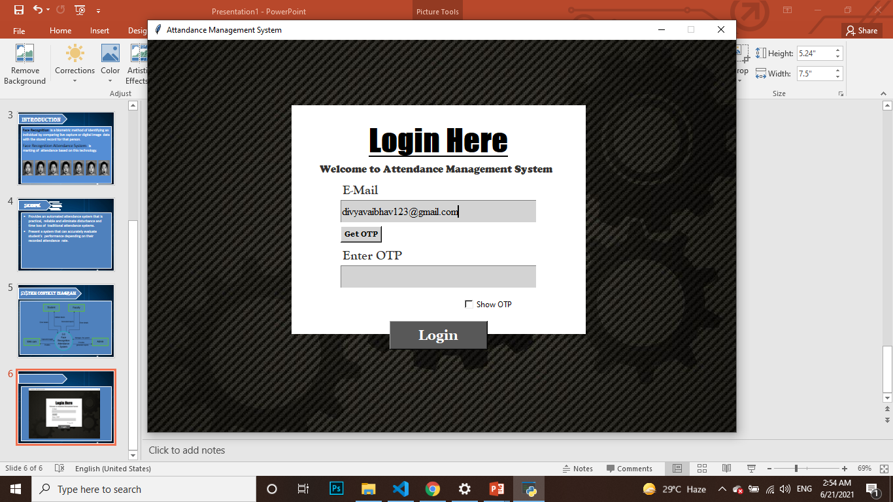
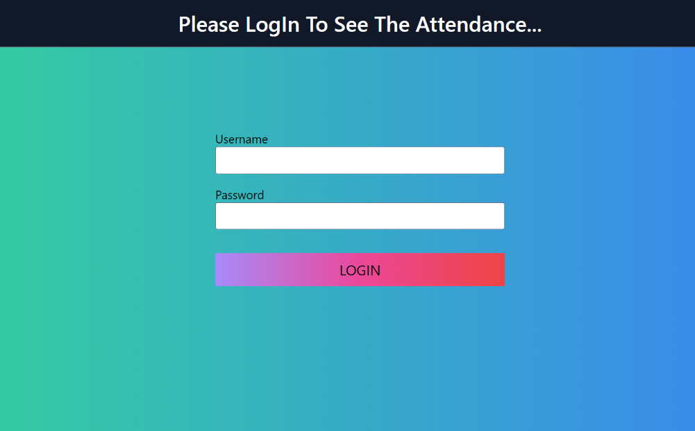
APPENDIX
SYSTEM LOGIN:
WEBSITE LOGIN

Slide 34
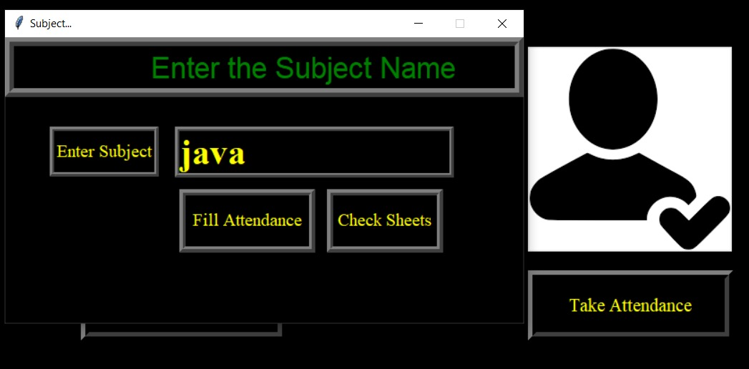
MARKING ATTENDANCE SUBJECT

Slide 35
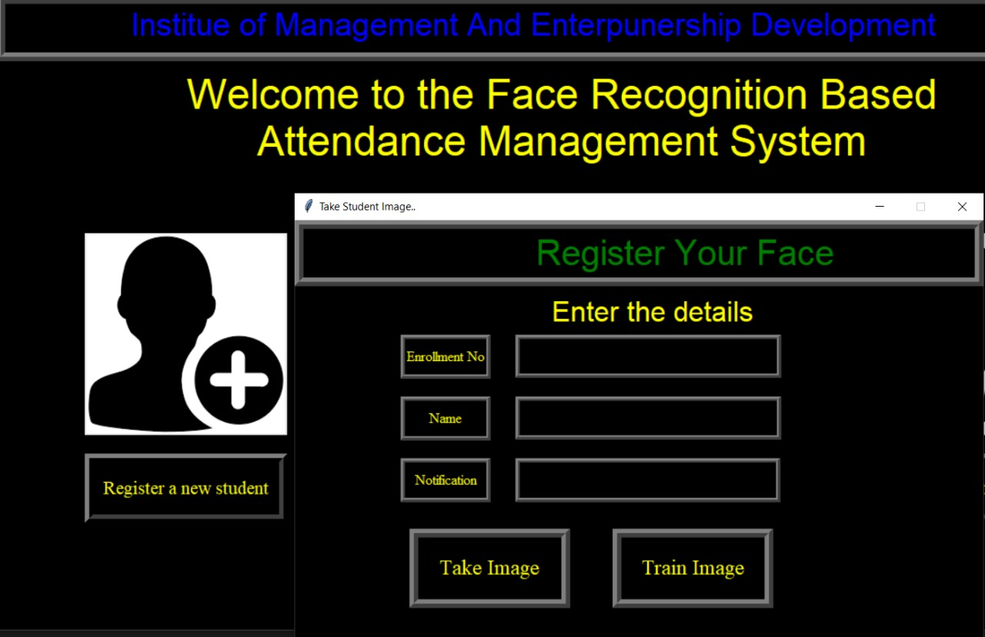
REGISTER FACE SNAP

Slide 36




OUR TEAM
Nandita Dutta
Vaibhav Divya
Saurabh Prasad
Shreeya Mamindwar
Email:
duttanandita15@gmail.com
Email:
divyavaibhav123@gmail.com
Email: shreeyamamindwar14@gmail.com
Email:
saurbhprasad15@gmail.com

Slide 37
THANKS!
This presentation is created by Ms. Nandita Dutta for the academic project presentation in Sem –II Of MCA degree
Please keep this slide for attribution

